Slide 1

Global University Rankings
By: Angela Deslandes

Slide 2
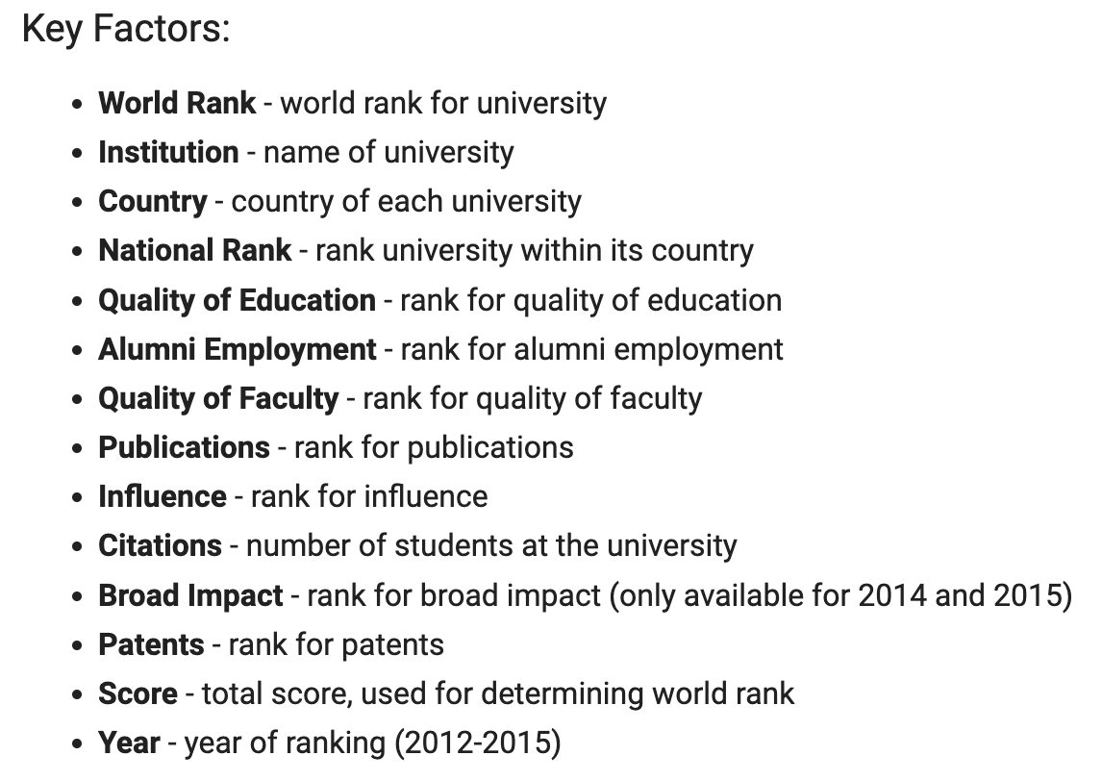
The Dataset
This dataset comes from The Center for World University Rankings (Kaggle), which provides information for top Universities in the World.
There are 14 columns and 2,220 rows of data.
This dataset revolves around the assessment and comparison of universities globally throughout the years 2012-2015.
Notes:
This dataset was pulled from Kaggle and comes from The Center for World University, which provides information for top universities in the world
14 features
2,220 records
The data revolves around the assessment and comparison of universities globally throughout the years 2012-2015.

Slide 3
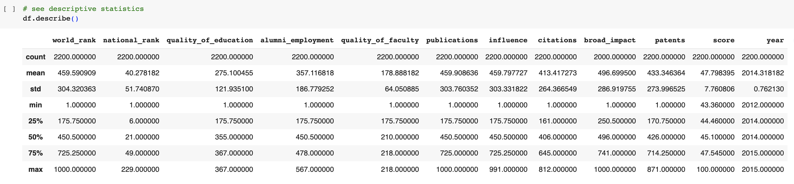
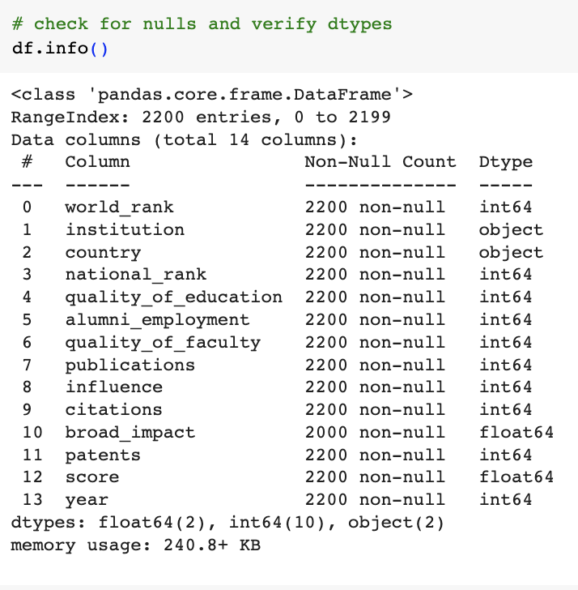
The data contains multiple columns, both qualitative and quantitative, ranging from nominal, discrete, and continuous variable types.
Tools used: Jupyter Notebook, Python (Numpy, Pandas, Matplotlib, Seaborn), Excel, and PowerPoint.
Notes:
The data contains multiple columns, both qualitative and quantitative, ranging from nominal, discrete, and continuous variable types.
Tools used were: Jupyter Notebook, Python (Numpy, Pandas, Matplotlib, Seaborn), Excel, and PowerPoint.

Slide 4

Research Questions
There are two main questions I would like to answer using this dataset:
The first is to investigate whether higher-ranked universities provide better quality education than lower-ranked universities.
The second is to explore whether higher-ranked universities have a greater number of publications than lower-ranked universities.
Notes:
There are two main questions I would like to answer using this dataset:
The first is to investigate whether higher-ranked universities provide better quality education than lower-ranked universities.
The second is to explore whether higher-ranked universities have a greater number of publications than lower-ranked universities.

Slide 5

Hypotheses
Hypothesis 1 - (Quality of Education):
Null Hypothesis (H0): There is no significant difference in the quality of education provided by higher-ranked and lower-ranked universities.
Alternative Hypothesis (H1): Higher-ranked universities provide better quality education than lower-ranked universities.
Hypothesis 2 - (Number of Publications):
Null Hypothesis (H0): There is no significant difference in the number of publications between higher-ranked and lower-ranked universities.
Alternative Hypothesis (H1): Higher-ranked universities have a greater number of publications than lower-ranked universities.
Notes:
I’ve based my hypotheses around the Quality of Education and the Number of Publications a university has against the university ranking scores.
-
Null Hypothesis (H0): There is no significant difference in the quality of education provided by higher-ranked and lower-ranked universities.
Alternative Hypothesis (H1): Higher-ranked universities provide better quality education than lower-ranked universities.
Null Hypothesis (H0): There is no significant difference in the number of publications between higher-ranked and lower-ranked universities.
Alternative Hypothesis (H1): Higher-ranked universities have a greater number of publications than lower-ranked universities.

Slide 6
How will the data test the hypothesis?
The data will be used to test the hypotheses in the following ways:
Statistical analysis to assess the relationship between the number of university publications/quality of education and university ranking.
Pearson correlation coefficient to check correlation.
Independent t-test to check for average differences.
Visualizations: scatter plots, histograms, heatmap etc.
Notes:
In order to test the hypotheses, I used statistical analysis to assess the relationship between the university ranking scores and the amount of publications/quality of education
I have used the Pearson correlation coefficient and t-tests to further analyze the variables and plot the related data with a variety of visualizations.

Slide 7
How will the findings be used? Who will find it helpful?
University administrators can use the findings to gain insights into their own institution's performance and compare it with other universities worldwide.
Government officials and education policymakers may use the findings to understand the factors that contribute to higher-ranking universities.
Students and their parents may use the rankings and the analysis of different universities to make informed decisions about where to apply for higher education.
Notes:
How will these findings be used?
Who will find it helpful?
I have determined that there are at least 3 groups of people who will benefit from the findings:

Slide 8

Analyses

Slide 9
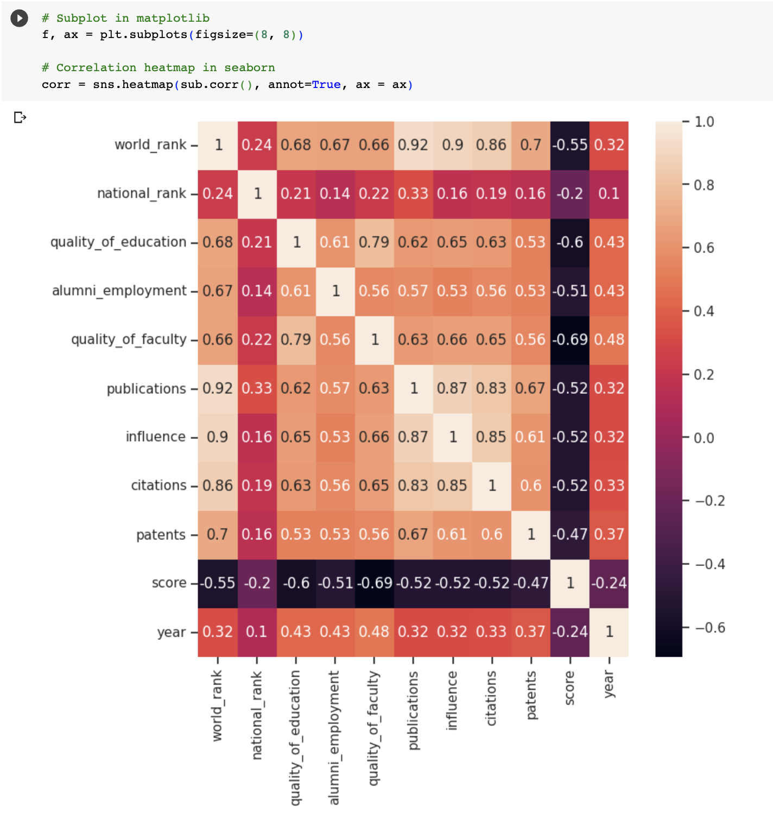
Which features?
Using a heatmap with seaborn, we can determine the relationships between variables.
We can see there are strong relationships between the publication rank and the world rank (0, 92)
Notes:
In order to determine the relationships between the variables, I created a heat map which shows that:
Publication/World Rank has a coefficient of .92

Slide 10
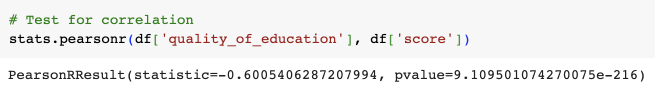
Hypothesis #1
The difference in means, which is negative and falls within a specific confidence interval, supports the idea that higher-ranked universities might indeed have a better quality of education compared to lower-ranked universities.
The Pearson correlation coefficient of approximately -0.60 suggests a moderate to strong negative linear correlation. This means that as the quality of education increases, the score tends to decrease.
The very low p-value indicates that the observed correlation is statistically significant, providing evidence against the null hypothesis of no correlation.
Notes:
I created a function to calculate the confidence intervals at 95%. You can see in the first image the results when I called that function.
The difference in means supports the idea that higher-ranked universities might have a better quality of education compared to lower-ranked universities
The second image shows the p-value when testing for correlation with the Pearson correlation coefficient
The results show a moderate to strong negative linear correlation, meaning that as the quality of education increases the score decreases.
The p-value shows that the correlation is statistically significant, providing evidence against the null hypothesis.

Slide 11
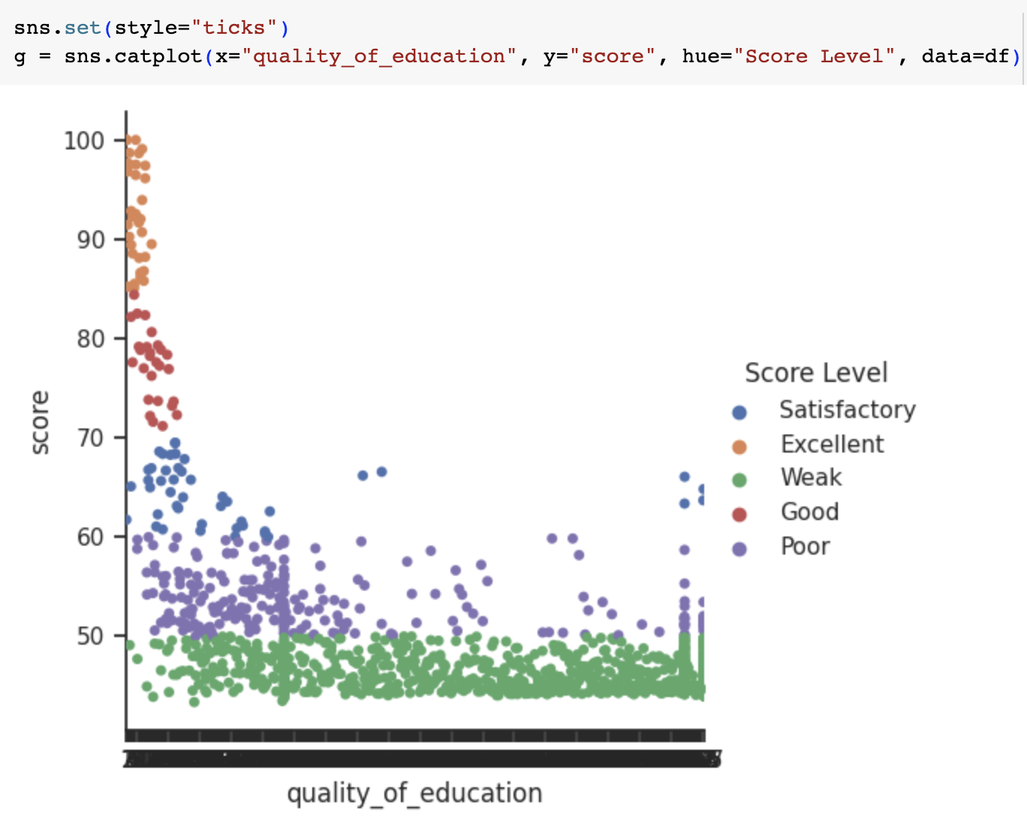
Hypothesis #1
Given these findings, both the Pearson correlation coefficient and the difference in means at the confidence interval provide evidence that supports the alternative hypothesis (H1). Higher-ranked universities appear to provide better quality education than lower-ranked universities, and there is a negative relationship between the quality of education and the ranking scores.
Overall, we can reject the null hypothesis and conclude that there is a statistically significant difference between the two variables being tested.
Notes:
For this visualization, I categorized the scores for ranking into different levels. What you see here indicates a connection between the score and the quality of education
and suggests that a moderate link exists
Quality of Education is pivotal for a student's academic achievements, although it's not the sole determinant, and other factors need to be taken into account as well.
Here we can reject the null and conclude that there is a statistically significant difference between the two variables

Slide 12
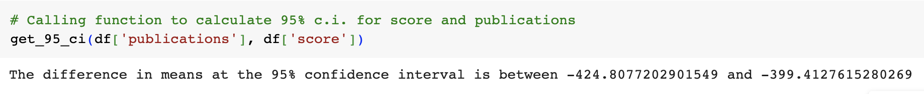
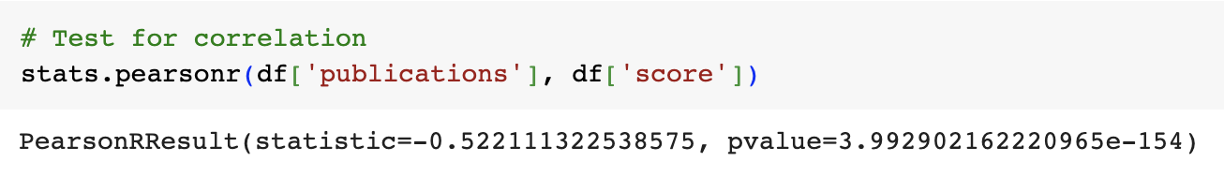
Hypothesis #2
The difference in means, which is negative and falls within the confidence interval, goes against the alternative hypothesis (H1), that higher-ranked universities have a greater number of publications. The confidence interval suggests that the difference in the number of publications between higher-ranked and lower-ranked universities is negative, indicating that higher-ranked universities tend to have fewer publications than lower-ranked universities.
The Pearson correlation coefficient of approximately -0.52 has a very low p-value, indicating a statistically significant correlation between the two variables. This suggests a moderate negative relationship between the number of publications and the ranking of universities and implies that as the ranking of universities increases, the number of publications tends to decrease.
The very low p-value indicates that the observed correlation is statistically significant. This means that the observed correlation between the number of publications and university rankings is unlikely to have occurred by chance.
Notes:
Here, the difference in means at 95% confidence, goes against the alternate hypothesis, that higher-ranked universities have a greater number of publications than lower-ranked universities.
The p-value from the Pearson correlation coefficient is very low, indicating a statistically significant difference between the two variables.
This implies that as the ranking of universities increases, the number of publications tends to decrease.

Slide 13
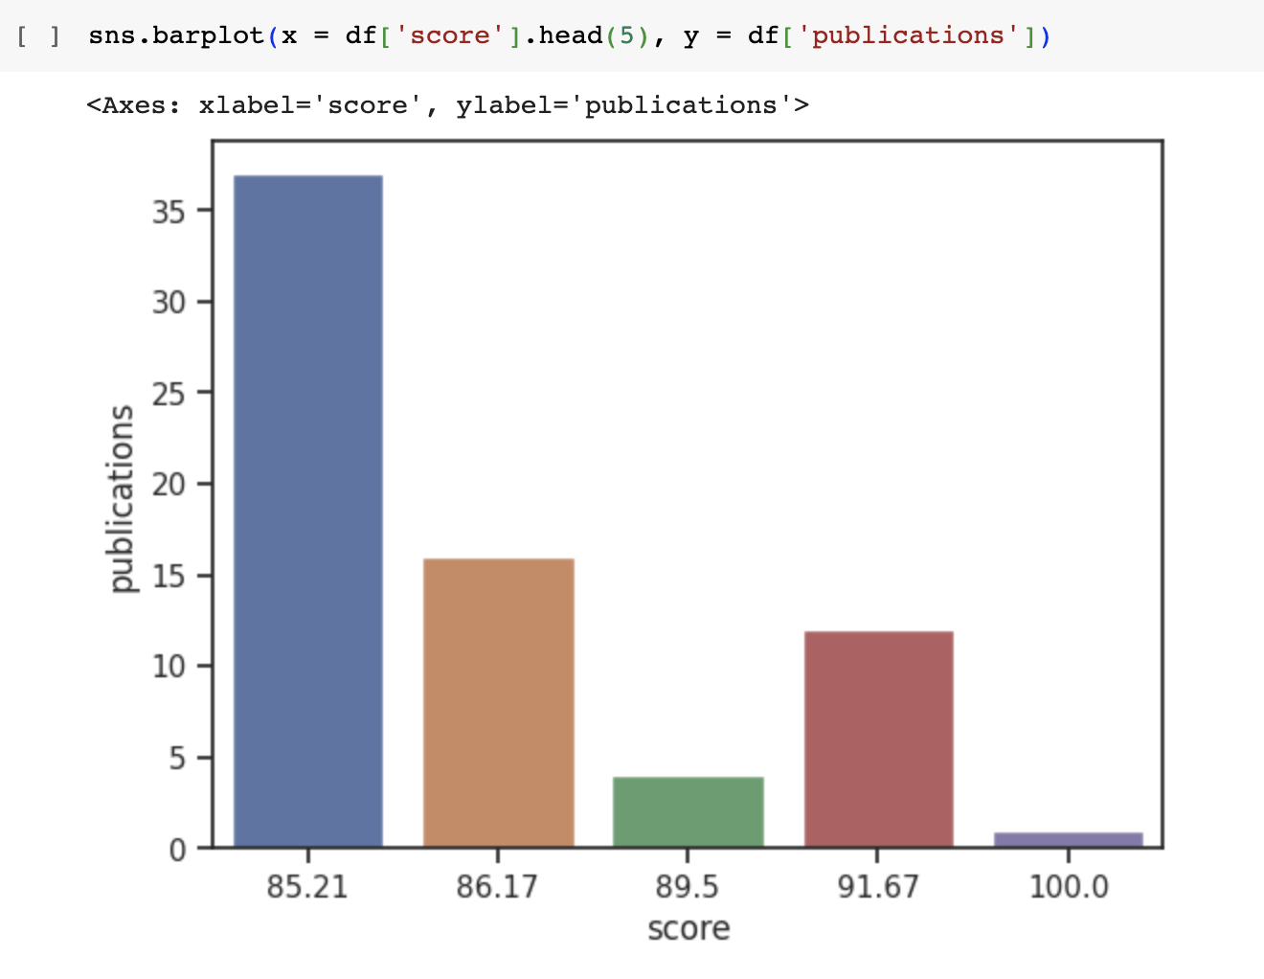
Hypothesis #2
Given that the calculated difference in means and the correlation coefficient both suggest a negative relationship between university ranking and the number of publications, the results do not support the alternative hypothesis (H1). Higher-ranked universities tend to have a lower number of publications than lower-ranked universities, and there is a negative relationship between the publications and the ranking scores. This conclusion is consistent with both the Pearson correlation coefficient and the calculated difference in means.
Overall, we can accept the null hypothesis and conclude that there is a statistically significant difference between the two variables being tested.
Notes:
In this graph, you can see that the more publications a university has, the lower the score is in ranking, concluding that higher ranking universities write less publications than those with a lower ranking.
Given that the calculated difference in means and the correlation coefficient both suggest a negative relationship between university ranking and the number of publications, the results do not support the alternative hypothesis (H1).
Here we can accept the null and conclude there is a statistically significant difference between the two variables

Slide 14

Conclusion

Slide 15
Project Summary
For Hypothesis #1, the investigation into the relationship between university ranking scores and the quality of education has shown evidence in favor of the alternative hypothesis (H1).
The negative correlation observed between educational quality and ranking scores underlines the significance of a robust education in shaping a university's standing. This robust evidence enables us to confidently reject the null hypothesis, affirming the pivotal role of education quality in the university rankings
Conversely, for Hypothesis #2, an analysis between university ranking scores and the number of publications has revealed that from both the calculated difference in means and the Pearson correlation coefficient, evidence reinforces the null hypothesis.
This suggests that while the number of publications and university rankings do exhibit a negative correlation, the relationship is complex.
Notes:
To summarize,
Hypothesis #1 - The investigation into the relationship between university ranking scores and the quality of education has shown evidence in favor of the alternative hypothesis (H1).
Alternative Hypothesis (H1): Higher-ranked universities provide better quality education than lower-ranked universities.
Conversely,
Hypothesis #2 – The analysis between university ranking scores and the number of publications has revealed that the evidence reinforces the null hypothesis.
Null Hypothesis (H0): There is no significant difference in the number of publications between higher-ranked and lower-ranked universities.

Slide 16
Recommendations
Focus on Quality of Education Alongside Other Factors:
Although the publications are essential, universities should prioritize providing high-quality education. The analysis showed that world rank and education quality rank are not always directly related. This can be achieved by maintaining rigorous academic standards, investing in faculty development, promoting innovative teaching methods, and continuously assessing and improving educational programs.
Emphasize the importance of Publications:
The correlation between publication rank and world rank implies that universities should focus on improving their research output and publications. This can be achieved by investing in research facilities, supporting faculty members in their research, and collaborating with other institutions.
Notes:
Focus on Quality of Education Alongside Other Factors:
This can be achieved by
maintaining rigorous academic standards,
investing in faculty development,
promoting innovative teaching methods,
and continuously assessing and improving educational programs.
Emphasize the importance of Publications:
This can be achieved by
investing in research facilities,
supporting faculty members in their research,
and collaborating with other institutions

Slide 17

Thank You!
Email
LinkedIn
Portfolio

